Slide 1
The lecture 11
Routing fundamentals

Slide 2
Static routing
Network administrators use static routing, or nonadaptive routing, to define a route when there is a single route or a preferred route for traffic to reach a destination. Static routing uses small routing tables with only one entry for each destination. It also requires less computation time than dynamic routing because each route is preconfigured.
Because static routes are preconfigured, administrators must manually reconfigure routes to adapt to changes in the network when they occur. Static routes are generally used in networks where administrators don't expect any changes

Slide 3
Static routing

Slide 4
Static routing

Slide 5
Static routing

Slide 6
STATIC ROUTES

Slide 7
Dynamic routing
Dynamic routing, sometimes called adaptive routing, is more complex than static routing because it creates more possible routes to send packets across a network.
Dynamic routes are typically used in larger, fluid networks where static routes would be cumbersome to maintain and frequently reconfigure.
Because dynamic routing is more complicated, it consumes more bandwidth than static routing.

Slide 8
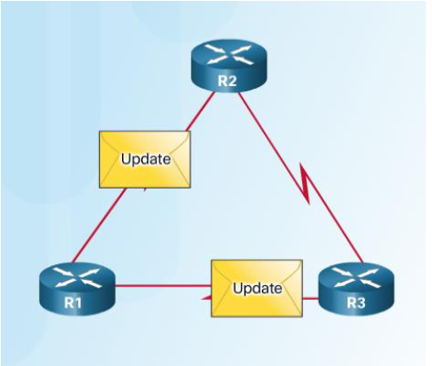
Dynamic Routing Protocol Components
Purpose of dynamic routing protocols includes: • Discovery of remote networks • Maintaining up-to-date routing information • Choosing the best path to destination networks • Ability to find a new best path if the current path is no longer available
The main components of dynamic routing protocols include: • Data structures - tables or databases kept in RAM. • Routing protocol messages - to discover neighboring routers, exchange routing information, and maintain accurate information about the network. • Algorithms – to facilitate learning routing information and for best path determination.

Slide 9
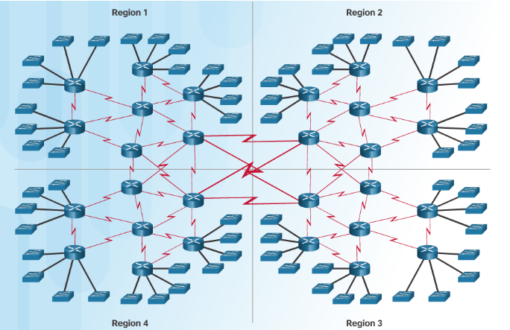
Dynamic Routing
Dynamic routing is the best choice for large networks
Dynamic routing protocols help the network administrator manage the network: • Providing redundant paths • Automatically implementing the alternate path when a link goes down.

Slide 10
Routing Information Protocol
Routing Information Protocol (RIP) is a distance-vector routing protocol. Routers running the distance-vector protocol send all or a portion of their routing tables in routing-update messages to their neighbors.
You can use RIP to configure the hosts as part of a RIP network. This type of routing requires little maintenance and also automatically reconfigures routing tables when your network changes or network communication stops.
Router RIP Configuration Mode
Use the no router rip command to disable RIP

Slide 11
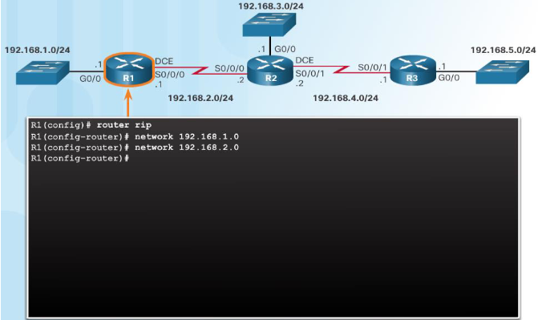
Configuring the RIP Protocol Advertise Networks
The network network-address router configuration mode command: • Enables RIP on all interfaces that belong to a specific network • Advertises the network in RIP routing updates sent to other routers every 30 seconds.
Note: RIPv1 is a classful routing protocol for IPv4

Slide 12
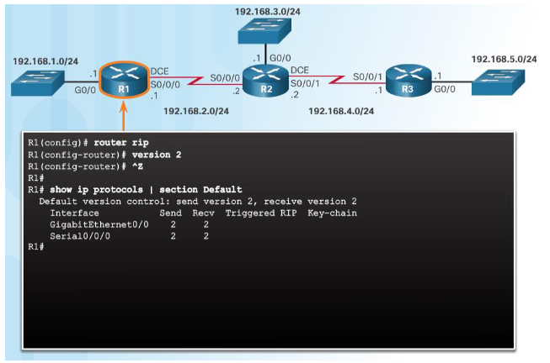
Enable and Verify RIPv2
Use the version 2 router configuration mode command to enable RIPv2
Use the show ip protocols command to verify that RIPv2 is configured.
Use the show ip route command to verify the RIPv2 routes in the routing table.

Slide 13
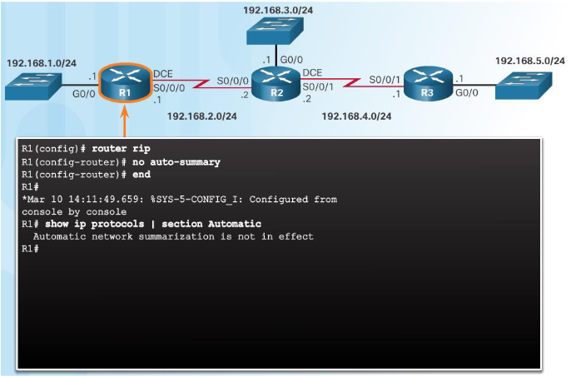
Disable Auto Summarization
RIPv2 automatically summarizes networks at major network boundaries.
Use the no auto-summary router configuration mode command to disable auto summarization.
Use the show ip protocols command to verify that auto summarization is off.

Slide 14
OSPF protocol
Open Shortest Path First (OSPF) is a link-state routing protocol that was developed for IP networks and is based on the Shortest Path First (SPF) algorithm. OSPF is an Interior Gateway Protocol (IGP).
In an OSPF network, routers or systems within the same area maintain an identical link-state database that describes the topology of the area.
Each router or system in the area generates its link-state database from the link-state advertisements (LSAs) that it receives from all the other routers or systems in the same area and the LSAs that itself generates. An LSA is a packet that contains information about neighbors and path costs.
Based on the link-state database, each router or system calculates a shortest-path spanning tree, with itself as the root, using the SPF algorithm.

Slide 15
OSPF protocol
OSPF has the following key advantages: Compared with distance-vector routing protocols such as the Routing Information Protocol (RIP), OSPF is more suitable for serving large, heterogeneous internetworks. OSPF can recalculate the routes in a short amount of time when the network topology changes.
With OSPF, you can divide an Autonomous System (AS) into areas and keep area topologies separate to decrease the OSPF routing traffic and the size of the link-state database of each area.
OSPF provides equal-cost multipath routing. You can add duplicate routes to the TCP stack using different next hops.

Slide 16
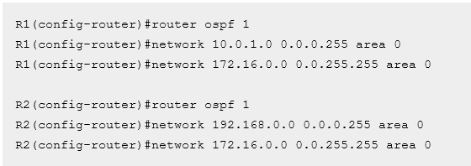
OSPF protocol
Let’s get started with some basic OSPF routing protocol configuration. We will use the following network topology

Slide 17
OSPF protocol
Although basic OSPF configuration can be straightforward, OSPF provides many extra features that can get really complex. In this example, we will configure a multiarea OSPF network and some other OSPF features.
Consider the following multiarea OSPF network. Assume that the IP address and the basic configurations are already configured on each device.
We have two OSPF areas – area 0 and area 1. As you can see from the network topology depicted above, routers R1 and R3 are in area 0 and area 1, respectively. Router 2 connects to both areas, which makes him an ABR (Area Border Router). Our goal is to advertise the subnets directly connected to R1 and R3 by entering the following configurations on R1:

Slide 18
EIGRP protocol
The Enhanced Interior Gateway Routing Protocol (EIGRP) is an enhanced version of the Interior Gateway Routing Protocol (IGRP) developed by Cisco. The convergence properties and the operating efficiency of EIGRP have improved substantially over IGRP, and IGRP is now obsolete.
EIGRP Features
Increased network width--With IP Routing Information Protocol (RIP), the largest possible width of your network is 15 hops. When EIGRP is enabled, the largest possible width is increased to 100 hops, and the EIGRP metric is large enough to support thousands of hops.
Fast convergence--The DUAL algorithm allows routing information to converge as quickly as any currently available routing protocol.
Partial updates--EIGRP sends incremental updates when the state of a destination changes, instead of sending the entire contents of the routing table. This feature minimizes the bandwidth required for EIGRP packets.
Neighbor discovery mechanism--This simple protocol-independent hello mechanism is used to learn about neighboring devices.
Scaling--EIGRP scales to large networks.

Slide 19
EIGRP protocol
EIGRP configuration closely resembles RIP configuration. Only two steps are required:
enabling EIGRP by using the router eigrp ASN_NUMBER command
telling EIGRP which networks to advertise by using one or more network statements
The first command, router eigrp ASN_NUMBER, enables EIGRP on a router. ASN_NUMBER represents an autonomous system number and has to be the same on all routers running EIGRP, otherwise routers won’t become neighbors. The second command, network SUBNET, enables EIGRP on selected interfaces and specifies which networks will be advertised. By default, the network command takes a classful network number as the parameter.

Slide 20
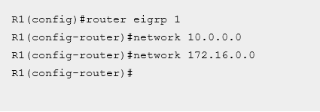
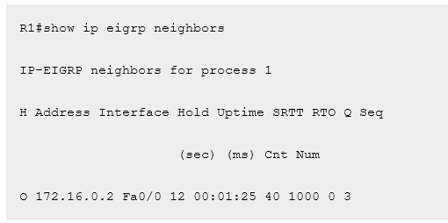
EIGRP protocol

Slide 21
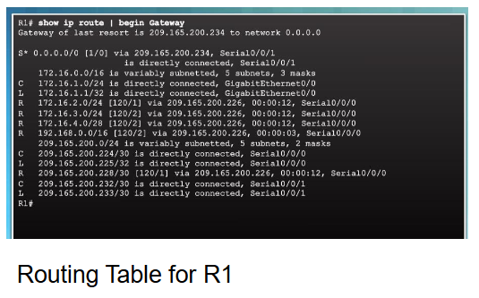
Routing Table Entries

Slide 22
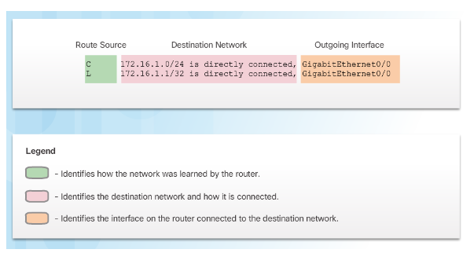
Routing Table Entries
Directly Connected Networks (C) are automatically added to the routing table when the interface is configured and activated.
Entries contain the following information: • Route source - how the route was learned. • Destination network – remote network. • Outgoing Interface – exit interface used to forward packets to destination.
Other route source entries include: • S –Static Route • D – EIGRP routing protocol • O – OSPF routing protocol • R - RIP routing protocol

Slide 23
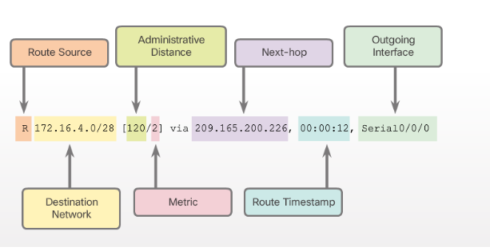
Routing Table Entries
Routes to remote networks contain the following information: • Route source – how route was learned • Destination network • Administrative distance (AD) - trustworthiness of the route. • Metric – value assigned to reach the remote network. Lower is better. • Next hop – IPv4 address of the next router that the packet should be forwarded to. • Route timestamp – time since the route was updated. • Outgoing interface - the exit interface to use to forward the packet

Slide 24
THANKS FOR ATTENTION!!!

